Slide 1
Data Analysis of Bike Sharing Company
Syed Saud Waqar

Slide 2
Contents
Introduction to Cyclistic
Business Task
01
02
Ride Length Comparison
Number of Rides Comparison
03
04
Top 3 Stations
05
06
Suggestions

Slide 3
Introduction to Cyclistic
A bike-share program that features more than 5,800 bicycles and 600 docking stations. Cyclistic sets itself apart by also offering reclining bikes, handtricycles, and cargo bikes, making bike-share more inclusive to people with disabilities and riders who can’t use a standard two-wheeled bike.
In 2016, Cyclistic launched a successful bike-share offering. Since then, the program has grown to a fleet of 5,824 bicycles that are geotracked and locked into a network of 692 stations across Chicago. The bikes can be unlocked from one station and returned to any other station in the system anytime.

Slide 4
Business Task
“To understand how casual riders and annual members use Cyclistic bikes differently.”
Note:
The complete R Markdown (.Rmd) file, documenting the entire data analysis process — from data collection and processing to analysis and visualization — is available upon request.

Slide 5
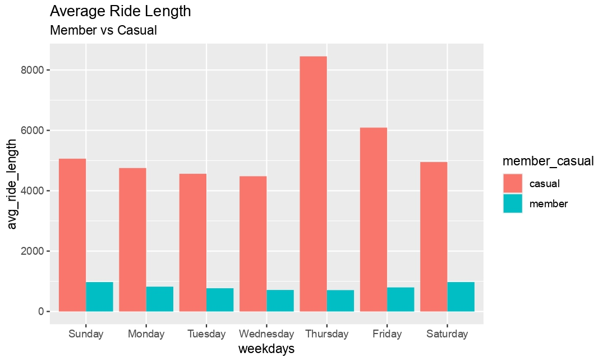
Ride Length Comparison
Casual group has much higher average ride length than member group
Maximum average ride length for casual was reported on Thursday
Minimum average ride length for casual was reported on Wednesday

Slide 6
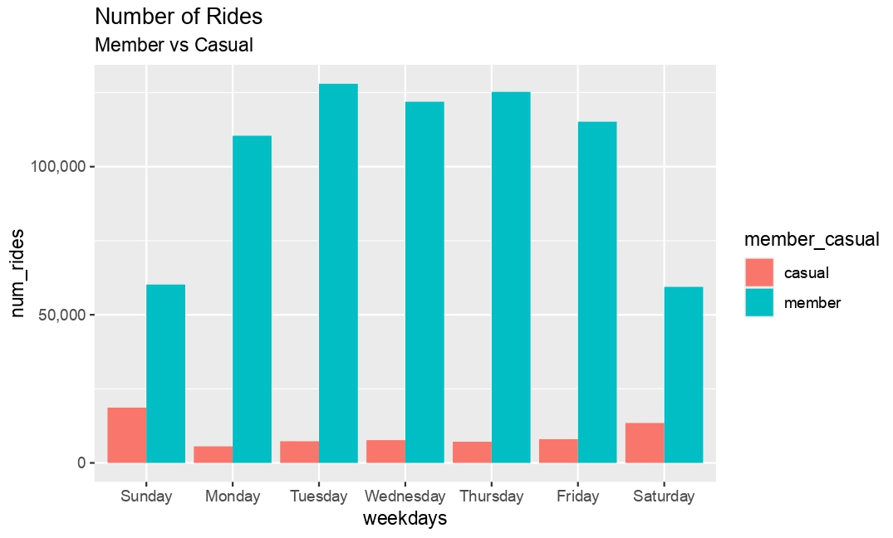
Number of Rides Comparison
Member group has more number of rides than casual group
The maximum number of rides for member was reported on Tuesday
The minimum number of rides for member was reported on Saturday

Slide 7
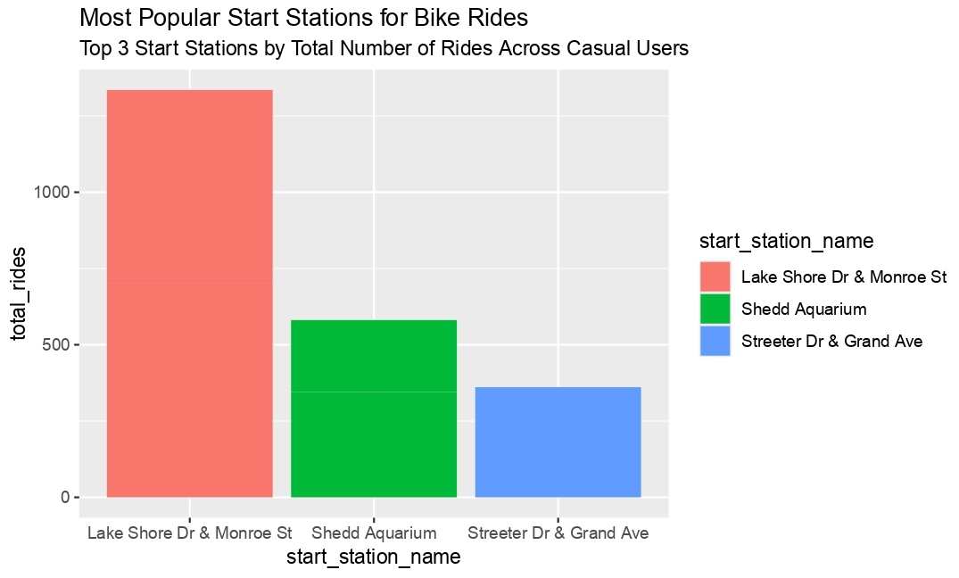
Top 3 Stations for Casual Users
Lake Shore Dr & Monroe St
Shedd Aquarium
Streeter Dr & Grand Ave

Slide 8
Suggestions
Proposed Marketing Strategies Based on Analysis
Target Longer Rides with Member-Exclusive Promotions:
Introduce promotions and discounts exclusively for members on longer rides. This strategy encourages casual users to purchase memberships by highlighting the cost benefits for members, given that casual users tend to have a higher average ride length.
Focus on High-Activity Stations with Member-Only Offers:
Implement special member-only promotions and discounts at the top three stations with the highest number of casual user rides. This approach incentivizes casual users to become members to access these exclusive benefits at key locations.

Slide 9
Thank You

